Slide 1

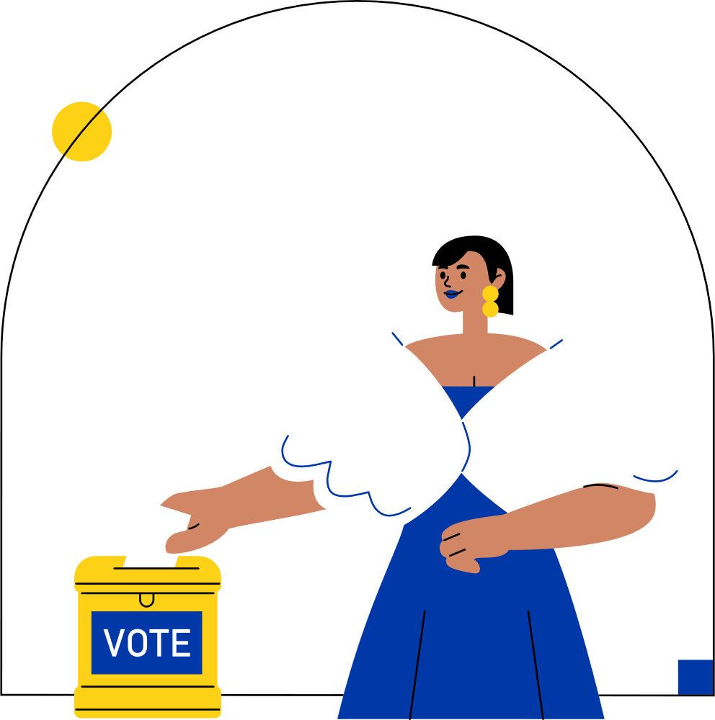

VISUALIZING ELECTION
DATA FOR A NEWS COMPANY
PRESENTED BY:
TEAM 4
BHUMI KALA
SANTOSH SK
SRINIBAS MASANTA
VAIBHAV YADAV

Slide 2
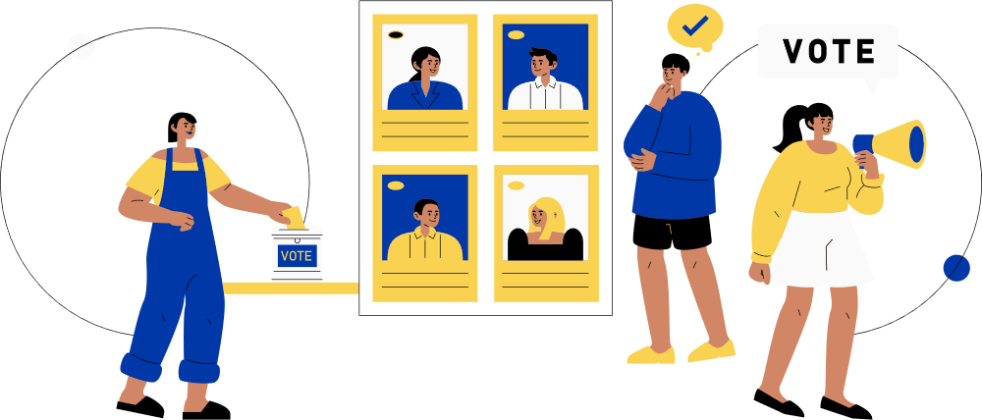

INTRODUCTION
In today’s fast-paced election environment, news agencies need accurate and real-time visualizations to effectively report voting trends and results. This project addresses that need by integrating complex election data from multiple sources into Power BI dashboards. These dashboards provide clear insights into vote shares, turnout patterns, party trends, and constituency-level performance, enabling journalists and editorial teams to analyze and present election data with clarity and speed. The solution is designed to be scalable and adaptable, supporting real-time updates and detailed demographic analysis to enhance news coverage and public understanding.

Slide 3
Constituency Information
Contains details about each parliamentary and assembly constituency.
Includes unique IDs, constituency names, and mapping to states.
State & Region Mapping
ABOUT THE DATASET
Each constituency is linked with its state and region.
Enables state-level comparisons and aggregated insights.
Electoral Boundaries
“The dataset contains detailed information on parliamentary and assembly constituencies, including IDs, names, and state mapping. It forms the backbone of the star schema, enabling constituency-level analysis of votes, candidates, and parties.”
Records boundary definitions to track constituency-level changes across elections.
Important for historical consistency and trend analysis.
Demographic Coverage
Captures urban–rural distribution and other constituency-level attributes.
Supports deeper insights into voter behavior and turnout trends.
Analytical Relevance
Serves as a dimension table in the Power BI star schema.
Forms the backbone for linking votes, candidates, and parties to their respective constituencies.

Slide 4
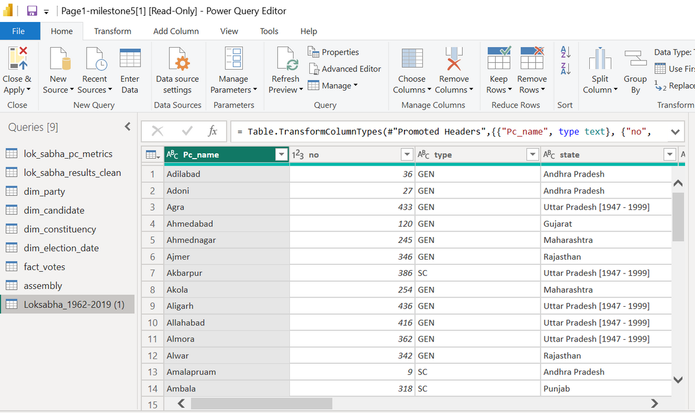
DATA CLEANING & TRANSFORMATION IN POWER BI
Ensured data accuracy and consistency by cleaning, transforming, and validating constituency datasets before Power BI integration.
🟨 Data Preparation in Power Query
Imported raw CSV (Lok Sabha 1962–2019)
Standardized text (Trim, Clean, Capitalize Each Word)
Unified party & constituency names (“BJP” → “Bharatiya Janata Party”)
🟨 Data Type & Column Formatting
Set correct data types (Year → Number, Votes → Whole Number)
Renamed columns (Cand_name → Candidate Name)
🟨 Derived Metrics & Validation
Created Vote Share (%) and Result (Winner/Loser) columns
Removed duplicates & null entries
Validated final dataset for completeness and accuracy

Slide 5

DATA INTEGRATION THROUGH API
API = Application Programming Interface
Acts as a bridge between data source and application
Enables real-time, structured, and automated access to datasets
Industry value: APIs reduce manual data handling and ensure consistency.
Source: [Datameet India Election Data API]
Taken from Github
Provides assembly election data across states and years
API Link: https://raw.githubusercontent.com/datameet/india-election-data/refs/heads/master/assembly-elections/assembly.csv
Data points include:
State & constituency
Candidate & party
Votes received
Election year

Slide 6
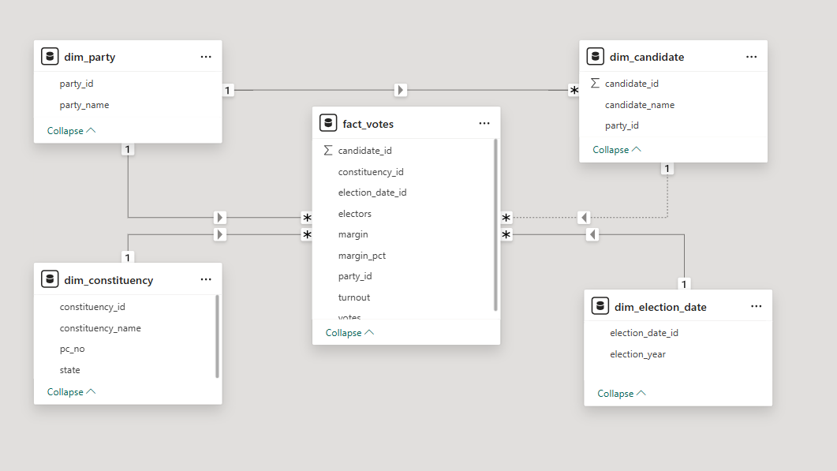
STAR SCHEMA
A star schema is a data warehousing model with a central fact table linked to multiple dimension tables, making data easier to analyze and query.
The fact table (fact_votes) sits at the center and stores measurable data like votes, turnout, and margins, with references to dimension tables.
Dimension tables (dim_party, dim_candidate, dim_constituency, dim_election_date) describe context such as parties, candidates, constituencies, and election dates.
Each dimension table connects to the fact table using foreign keys, enabling flexible filtering and grouping.

Slide 7
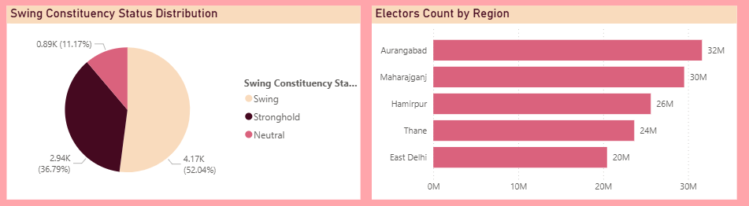
HISTORICAL TRENDS
Elections are not just numbers; they are stories of shifting public trust.
Historical vote shares and turnout patterns reveal:
What drives voter behavior?
Where do parties rise or decline?
Which regions decide outcomes?
Our dashboard turns raw data into narratives of democracy.

Slide 8
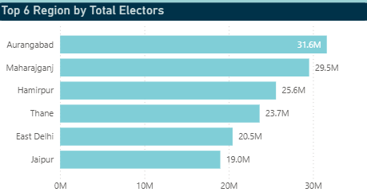
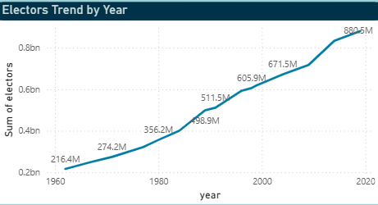
DEMOGRAPHIC TRENDS
Lok Sabha Election Insights
Scale: 834M electors, 8,047 candidates, 2,562 constituencies, 145 parties.
Key Findings:
Mulayam Singh Yadav represents the largest electorate (12M+), followed by other political heavyweights.
Candidate gender breakdown reveals male dominance across parties; female representation remains low.
Seats won are distributed across key constituencies, allowing identification of major strongholds and local dynamics.

Slide 9


RURAL & URBAN VOTER DYNAMICS
Urban and rural voting patterns together define India’s democracy. Urban regions, though densely populated and issue-driven, show modest turnout around 65%, lower than rural India’s. States like West Bengal, Uttar Pradesh, and Maharashtra lead in urban voters, yet apathy persists despite higher awareness, with exceptions like Puducherry and West Bengal crossing 80%.
Rural voters, meanwhile, often decide elections due to their vast numbers and strong participation, especially in states like Uttar Pradesh, Bihar, and Maharashtra. High engagement in regions like Nagaland and Lakshadweep showcases exceptional mobilization.
Bridging this turnout gap is vital for fair representation and realizing the full potential of India’s democracy.

Slide 10
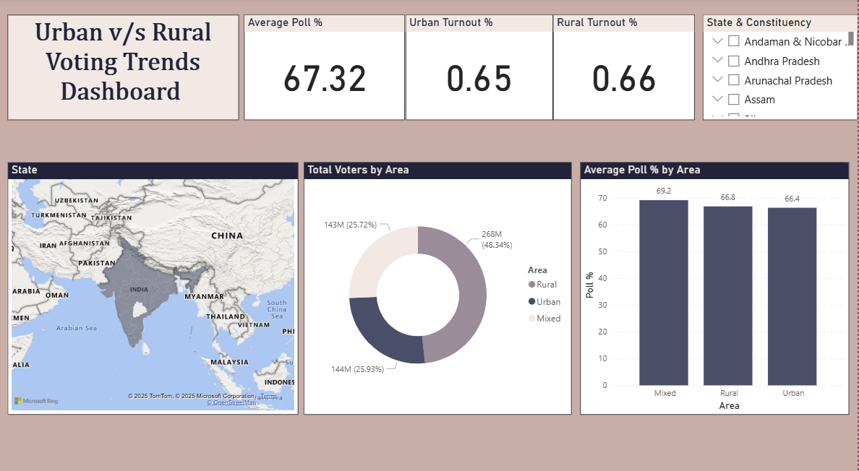

Slide 11
WHAT IS DRILL THROUGH?
Drill Through enables navigation from a summary dashboard to a detailed report page focused on a specific item like a region, candidate, or product.
When viewers right-click or select a data point, Power BI automatically opens a target page filtered to show granular details for that item only.
This makes analysis deeper and interactive, letting users explore the underlying reasons behind summary insights without cluttering the main dashboard.
Example: From overall state results, drill through to see details of a single state's voter turnout, candidate breakdown, or sales figures.
Why use it?
Enables focused, actionable insights.
Keeps dashboards clean while letting users investigate details as needed.

Slide 12
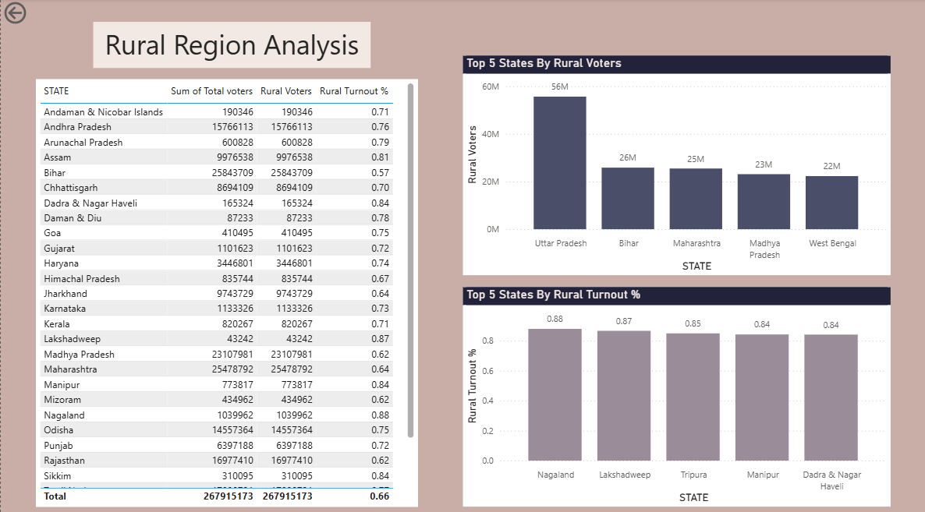
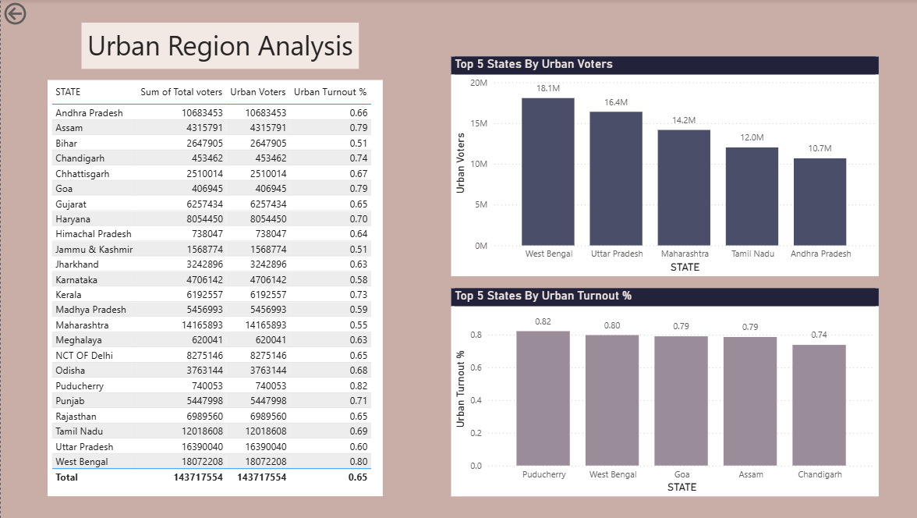

Slide 13
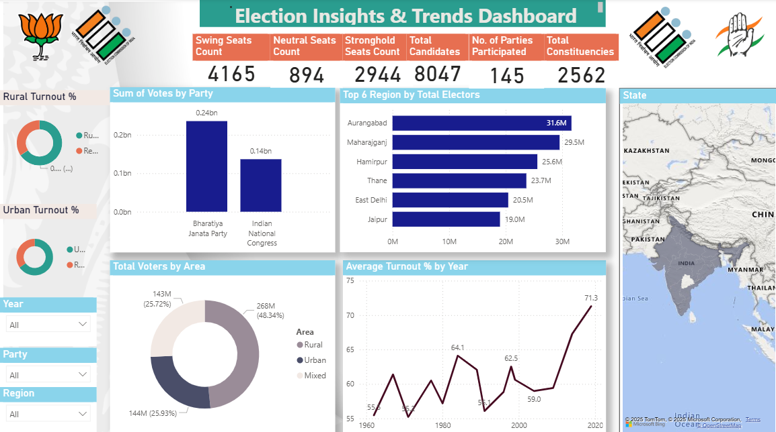

Slide 14
CONCLUSION
This project demonstrates how advanced data analytics and visualization in Power BI can transform raw election data into actionable insights for policymakers, campaigners, and the public. By integrating demographic breakdowns, urban and rural region analyses, and interactivity features like drill-through, the dashboard reveals both macro and micro-level trends in Indian elections.
Key takeaways include the dominance of certain states and candidates in the electorate, the persistent gender gap, and the contrasting turnout dynamics between rural and urban India. The project highlights untapped opportunities to boost urban voter participation and better represent demographic diversity.

Slide 15
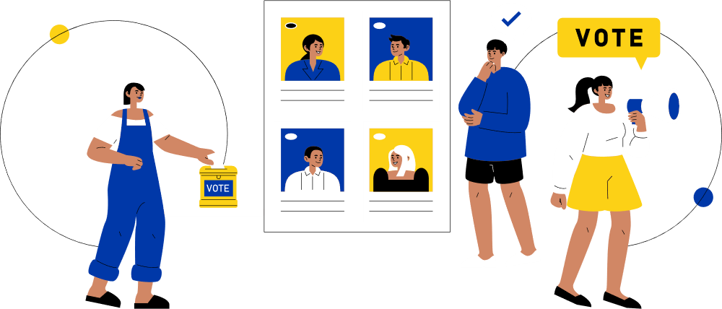
THANK YOU FOR LISTENING!

